Slide 1

Predicting the next recession
Machine Learning in the Econometric Space Jan. 18th, 2024
Christian Perera Lighthouse Labs Data Science Final Project

Slide 2
When is the next recession? Please Type your answer In the chatbox now!

Slide 3

Mayday – air crash investigation
Mayday uses re-enactments, interviews and computer-generated imagery to reconstruct for its audiences to the sequence of events leading up to each disaster.
Notes:
One of my hobbies is flying airplanes
Pilots all love to watch “Mayday – Air Crash Investigation”
Because Mayday traces the sequence of events leading
Up to each disaster This is much like the economy,
There is a sequence of events leading up to each recession

Slide 4
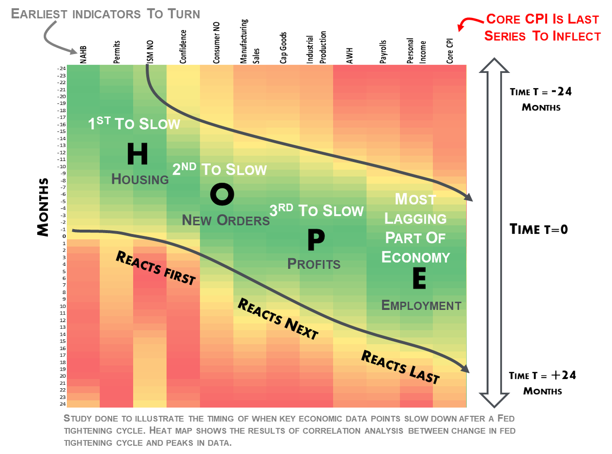
Notes:
Michael Kantrowitz of the Piper Sandler Company, in his excellent HOPE framework
Talks about how the sequence of economic events is H – Housing O – New Orders
P – Profits
E – Employment So we wanted to see if we could predict the
Next recession using these indicators available
From the Federal Reserve Economic Database in USA

Slide 5
Exploratory data analysis

Slide 6
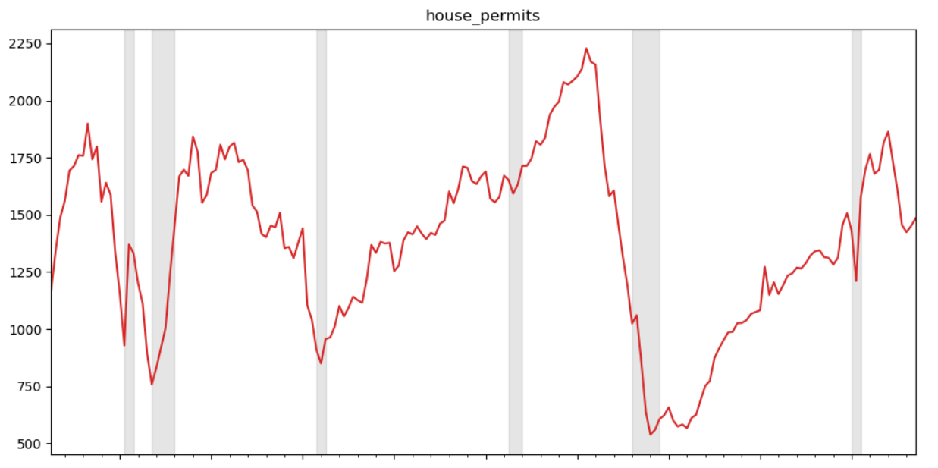

Notes:
As you can see here, building permits are down when entering a recession

Slide 7
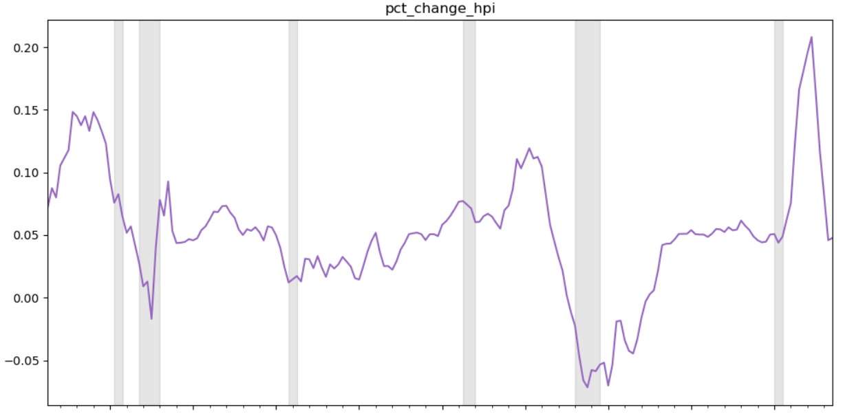

Notes:
The “HPI” or House Price Index is also down when entering a recession

Slide 8
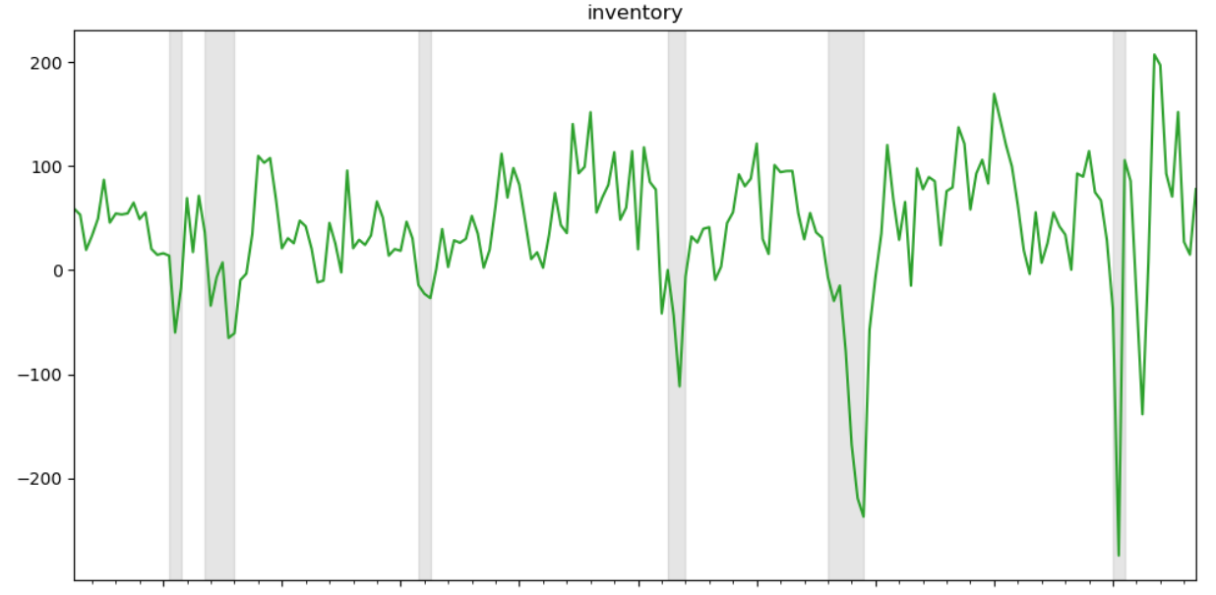
Notes:
Inventory of goods tends to tank when entering a recession

Slide 9
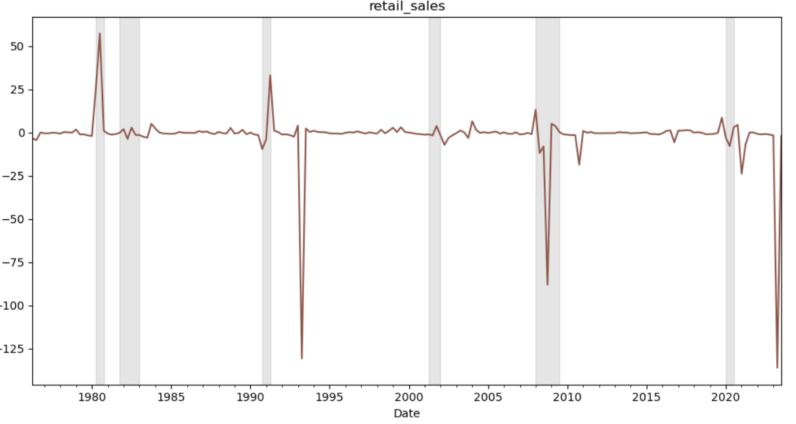
Notes:
Retail Sales tend to take a dip when entering a recession

Slide 10
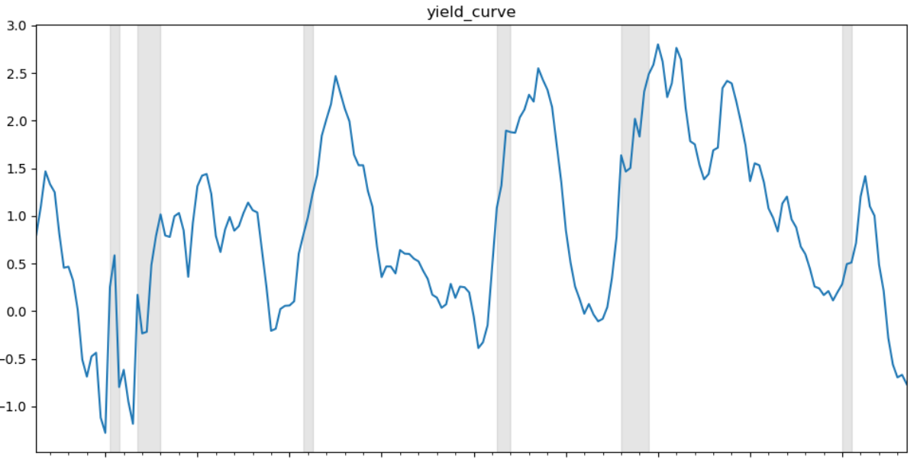
Notes:
And the yield curve tends to invert or go negative and then spike before a recession

Slide 11
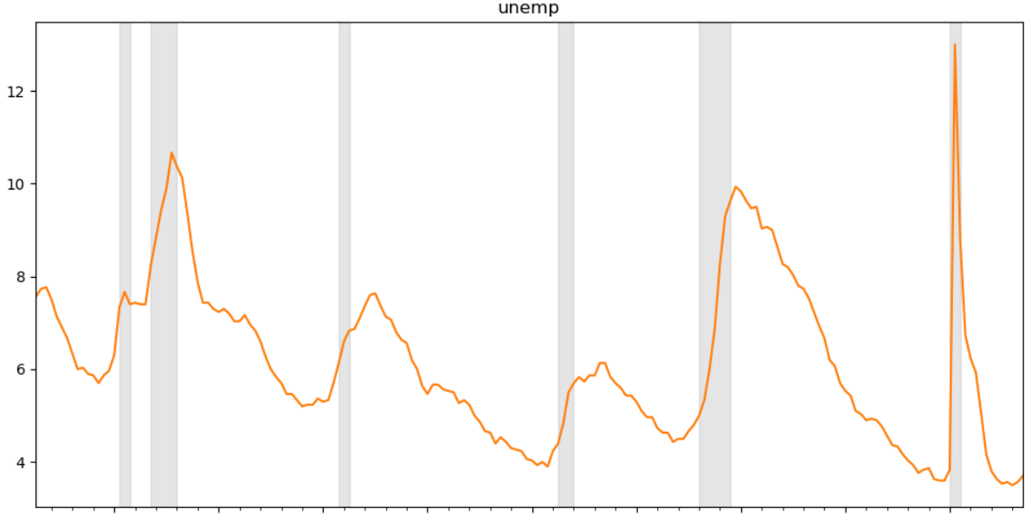
Notes:
And finally, employment tends to spike

Slide 12
Recession prediction engine
All data was provided by FRED API, however is 1-quarter delayed due to collection delays
Data from House Permits, Percent Change in HPI, Inventory, Retail Sales, Yield Curve and Unemployment Figures
Python with Numpy, Pandas
ScikitLearn StandardScalar and LinearSVC
ScikitLearn Pipeline
K-Fold Cross Validation
No Recession Predicted As At 3rd Quarter 2023
Notes:
So we created a “recession engine” with the following characteristics

Slide 13
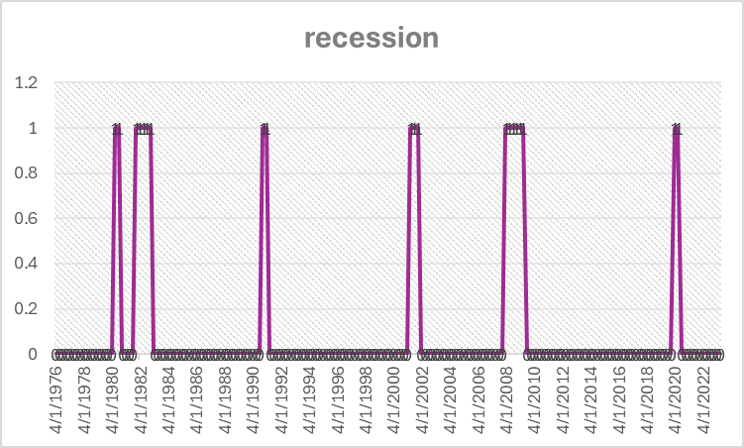
Recession prediction engine
Notes:
So we created a “recession engine” with the following characteristics

Slide 14
Recession prediction engine Analytics
Accuracy: 96.34%
# correct / total predictions – this is skewed because it’s an imbalanced dataset with very few recession quarters
F1 Score: 83.10
Harmonic mean of precision and recall
Precision: 87.35
Ratio of true positives to all positives (true and false)
Recall (sensitivity): 82.99
Ratio of true positives to [true positives + false negatives]
Notes:
So we created a “recession engine” with the following characteristics

Slide 15
Recession prediction engine Recommendations & future work
Because of latency of the dataset, delivering timely data to traders and portfolio managers is a problem
Consequently finding high-frequency data with similar predictive capability is the next step
Also, improving the Recall number of 82.99% so that we pick up all positives available is an improvement we can make. We’re missing 17.01% of positives.
The age old trade-off between bias and variance is where we’re going in terms of optimizing
Thank You!
Notes:
So we created a “recession engine” with the following characteristics

